Slide 1
Elias Eberhardsson
Mesh Deformation
Volumetric meshes

Slide 2
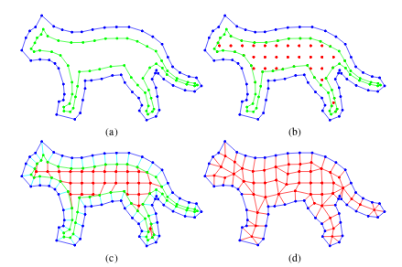
Research
VGL - KunZhuo
Triangle Intersection - Tomas Moller
Ductile fracturing - UCal

Slide 3
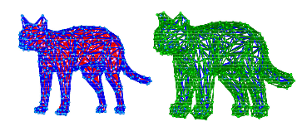
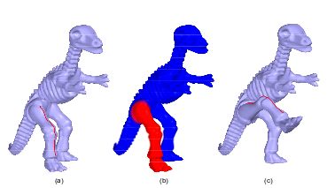
Goal
Volumetric 3-part mesh/Graph
Quadratic minimization
Laplace operations
WIRE deformation
Propagation

Slide 4
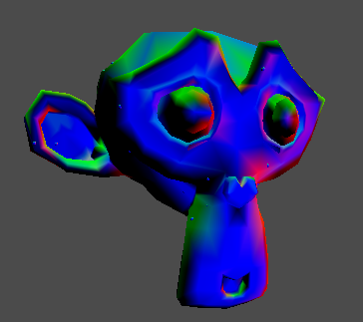
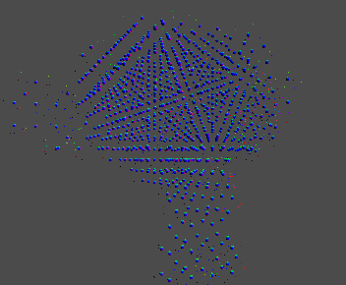
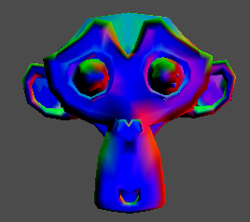
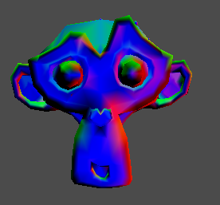
Results
Volumetric 2-part mesh/graph
Simple cheat position calculation
Laplace operations
Propagation

Slide 5

What went well
Understanding the paper
Laplace operator on manifolds
Volumetric graph

Slide 6

What went wrong
Time planning and management
Data structure
Quadratic minimization

Slide 7
And so...
… next time I will!

